Slide 1
Individual Business Report #3
By: Aaron Jones

Slide 2
Questions To Consider
Which products are selling the most?
How much of each product is being purchased?
How does this affect inventory?
Are there any noticeable trends or declines in any products?

Slide 3
Analytical Methods Used
Pivot Table
Line Chart
Bar Chart

Slide 4
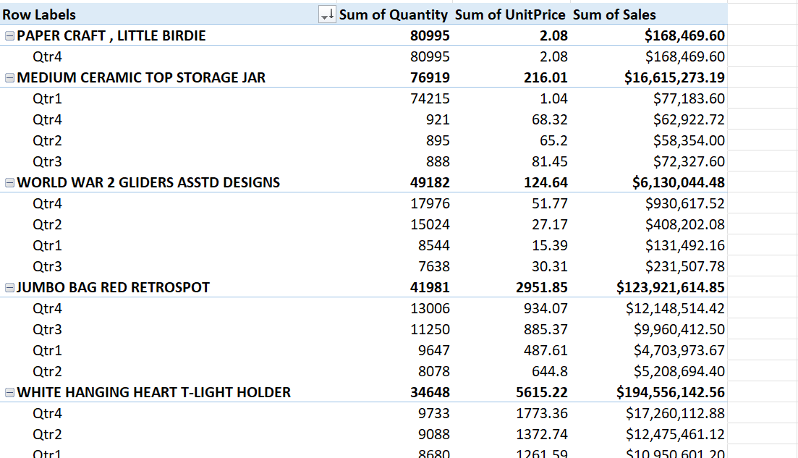
Pivot Table

Slide 5
Sales Calculation
Sales = Unit Price * Quantity

Slide 6
Highest Sales & Quantities by Product
Products With Highest Quantity
Products With Highest Sales
1. PAPER CRAFT , LITTLE BIRDIE
2. MEDIUM CERAMIC TOP STORAGE JAR
3. WORLD WAR 2 GLIDERS ASSTD DESIGNS
4. JUMBO BAG RED RETROSPOT
5. WHITE HANGING HEART T-LIGHT HOLDER
1. WHITE HANGING HEART T-LIGHT HOLDER
2. REGENCY CAKESTAND 3 TIER
3. JUMBO BAG RED RETROSPOT
4. PARTY BUNTING
5. ASSORTED COLOUR BIRD ORNAMENT

Slide 7
Top 20 Products Per Quarter
Top 20 Products by Highest Quantity
Top 20 Products by Highest Sales
Quarter 1 – 3 Products
Quarter 2 – 4 Products
Quarter 3 – 3 Products
Quarter 4 – 10 Products
Quarter 1 – 1 Product
Quarter 2 – 1 Product
Quarter 3 – 6 Products
Quarter 4 – 12 Products

Slide 8
Line Chart (Quantity)
Product | Q1 | Q2 | Q3 | Q4
PAPER CRAFT , LITTLE BIRDIE | - | - | - | 80995
MEDIUM CERAMIC TOP STORAGE JAR | 74215 | 895 | 888 | 921
WORLD WAR 2 GLIDERS ASSTD DESIGNS | 8544 | 15024 | 7638 | 17976
JUMBO BAG RED RETROSPOT | 9647 | 8078 | 11250 | 13006
WHITE HANGING HEART T-LIGHT HOLDER | 8680 | 9088 | 7147 | 9733
ASSORTED COLOUR BIRD ORNAMENT | 5268 | 5996 | 10742 | 10721
POPCORN HOLDER | - | 865 | 9959 | 18111
PACK OF 12 LONDON TISSUES | 6359 | 5912 | 5128 | 6938
BROCADE RING PURSE | 6895 | 5657 | 5402 | 4757
PACK OF 72 RETROSPOT CAKE CASES | 5193 | 5062 | 6466 | 5744

Slide 9
Line Chart (Quantity)

Slide 10
Line Chart (Sales)
Product | Q1 | Q2 | Q3 | Q4
WHITE HANGING HEART T-LIGHT HOLDER | $10,950,601.20 | $12,475,461.12 | $8,630,216.91 | $17,260,112.88
REGENCY CAKESTAND 3 TIER | $9,330,719.50 | $11,613,396.90 | $7,240,312.80 | $15,671,203.80
JUMBO BAG RED RETROSPOT | $4,703,973.67 | $5,208,694.40 | $9,960,412.50 | $12,148,514.42
PARTY BUNTING | $2,493,215.25 | $15,694,258.50 | $7,541,784.80 | $1,305,542.25
ASSORTED COLOUR BIRD ORNAMENT | $2,069,375.76 | $3,184,775.40 | $5,736,872.52 | $8,399,474.66
PAPER CHAIN KIT 50'S CHRISTMAS | $1,213.65 | $9,414.00 | $1,359,121.06 | $27,269,177.55
JUMBO BAG PINK POLKADOT | $1,320,913.83 | $1,467,681.21 | $2,722,536.96 | $2,195,602.57
SPOTTY BUNTING | $0.00 | $3,869,151.80 | $5,360,385.74 | $1,258,137.00
SET OF 3 CAKE TINS PANTRY DESIGN | $2,867,558.40 | $358,969.60 | $2,500,304.76 | $1,512,380.24
CHILLI LIGHTS | $1,431,904.00 | $345,757.50 | $933,502.54 | $5,518,074.12

Slide 11
Line Chart (Sales)

Slide 12
Bar Chart
Months | Quantity | Sales
Jan-11 | 278259 | $15,625,266,843.12
Feb-11 | 213307 | $11,686,186,108.32
Mar-11 | 276259 | $19,923,962,072.81
Apr-11 | 260348 | $16,092,013,551.24
May-11 | 301806 | $23,556,589,074.54
Jun-11 | 280922 | $20,066,008,439.42
Jul-11 | 303490 | $19,080,449,683.90
Aug-11 | 310782 | $19,443,463,589.46
Sep-11 | 454010 | $44,647,933,613.00
Oct-11 | 475726 | $57,932,689,664.17
Nov-11 | 579895 | $90,906,793,155.85
Dec-11 | 527349 | $59,936,720,720.84

Slide 13
Bar Chart

Slide 14
Recommendations
Inventory management
Keeping an eye on high-performing products
Use pricing methods and promotions during down season
Focus on seasonal marketing
Focus on operations during the peak era.

